Slide 1






Clusters in Denmark
A fairy taler

Slide 2

The first years
– establishment of clusters

Slide 3
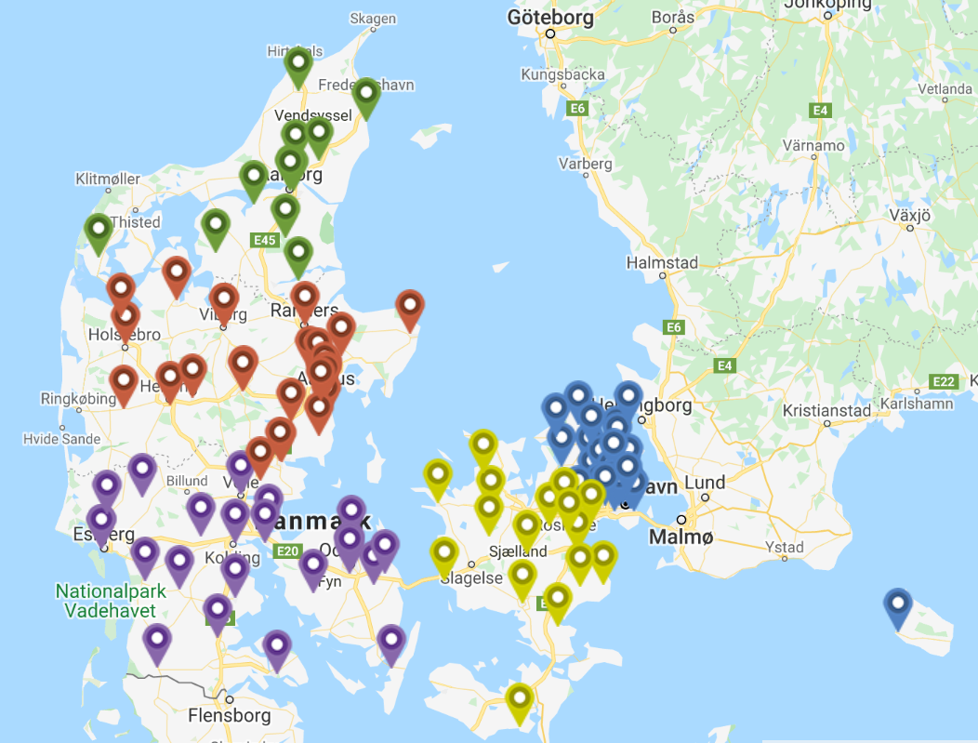
Rapid establishment- 114 clusters with 3.256 docters and 5,5 mio. patients
Region Hovedstaden: 33 Clusters
Region Sjælland: 16 Clusters
Region Syddanmark: 24 Clusters
Region Midtjylland: 29 Clusters
Region Nordjylland: 12 Clusters
98-99 % af GP´s are organized in clusters

Slide 4
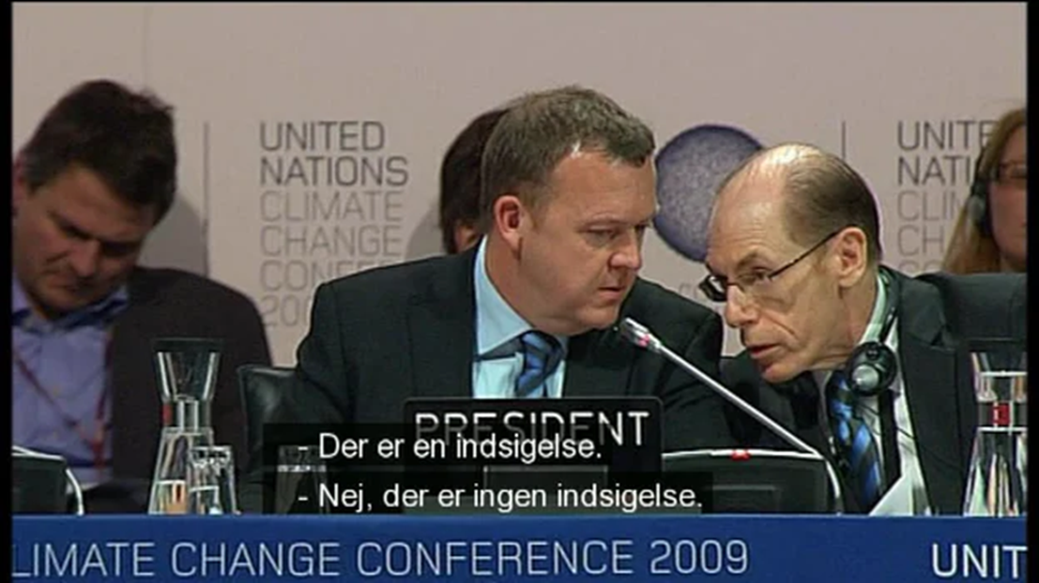

Proces, proces, proces….

Slide 5
Two attitude surveys
- in 2019 and 2021

Slide 6
Insights - what do the GP´s want?
Plug and play sollutions
Minimal preparation before clustermeetings
Access to valid real time data over time

Slide 7

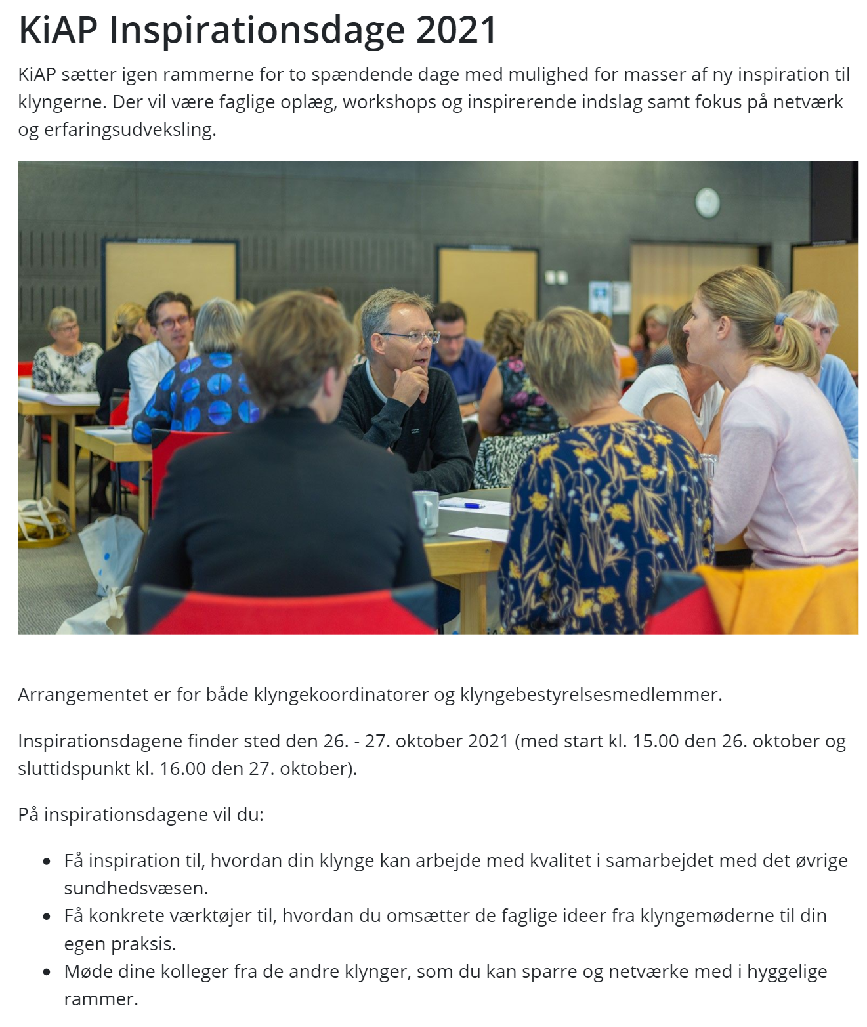
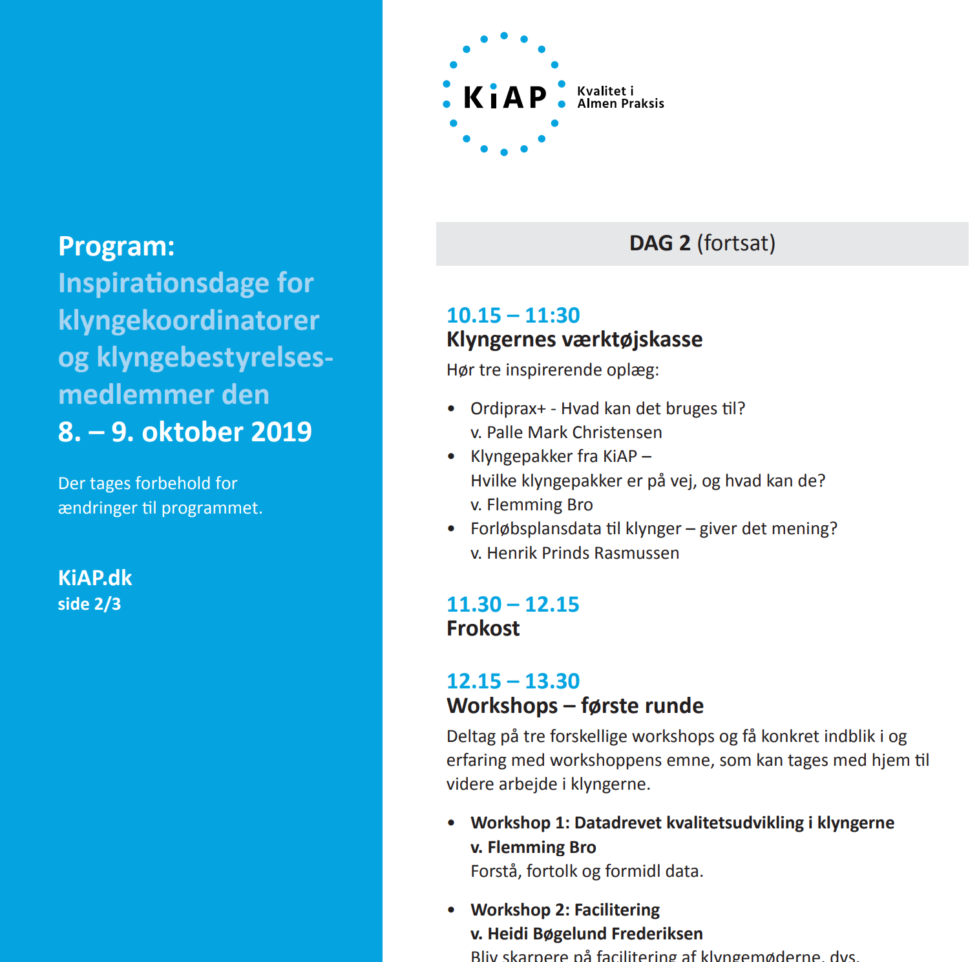
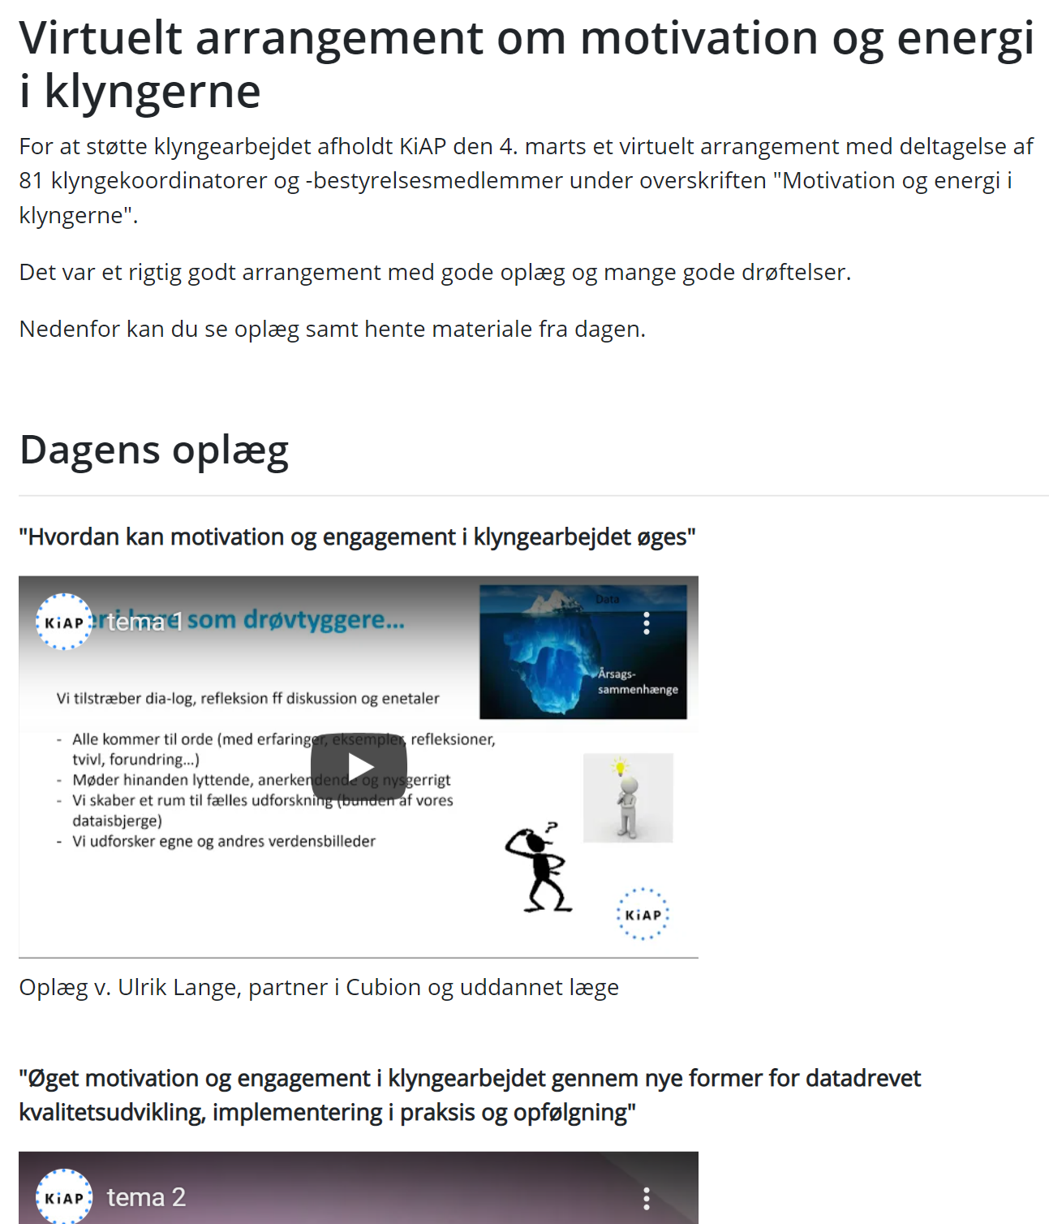
KiAP’s cluster support (National and regional)

Slide 8

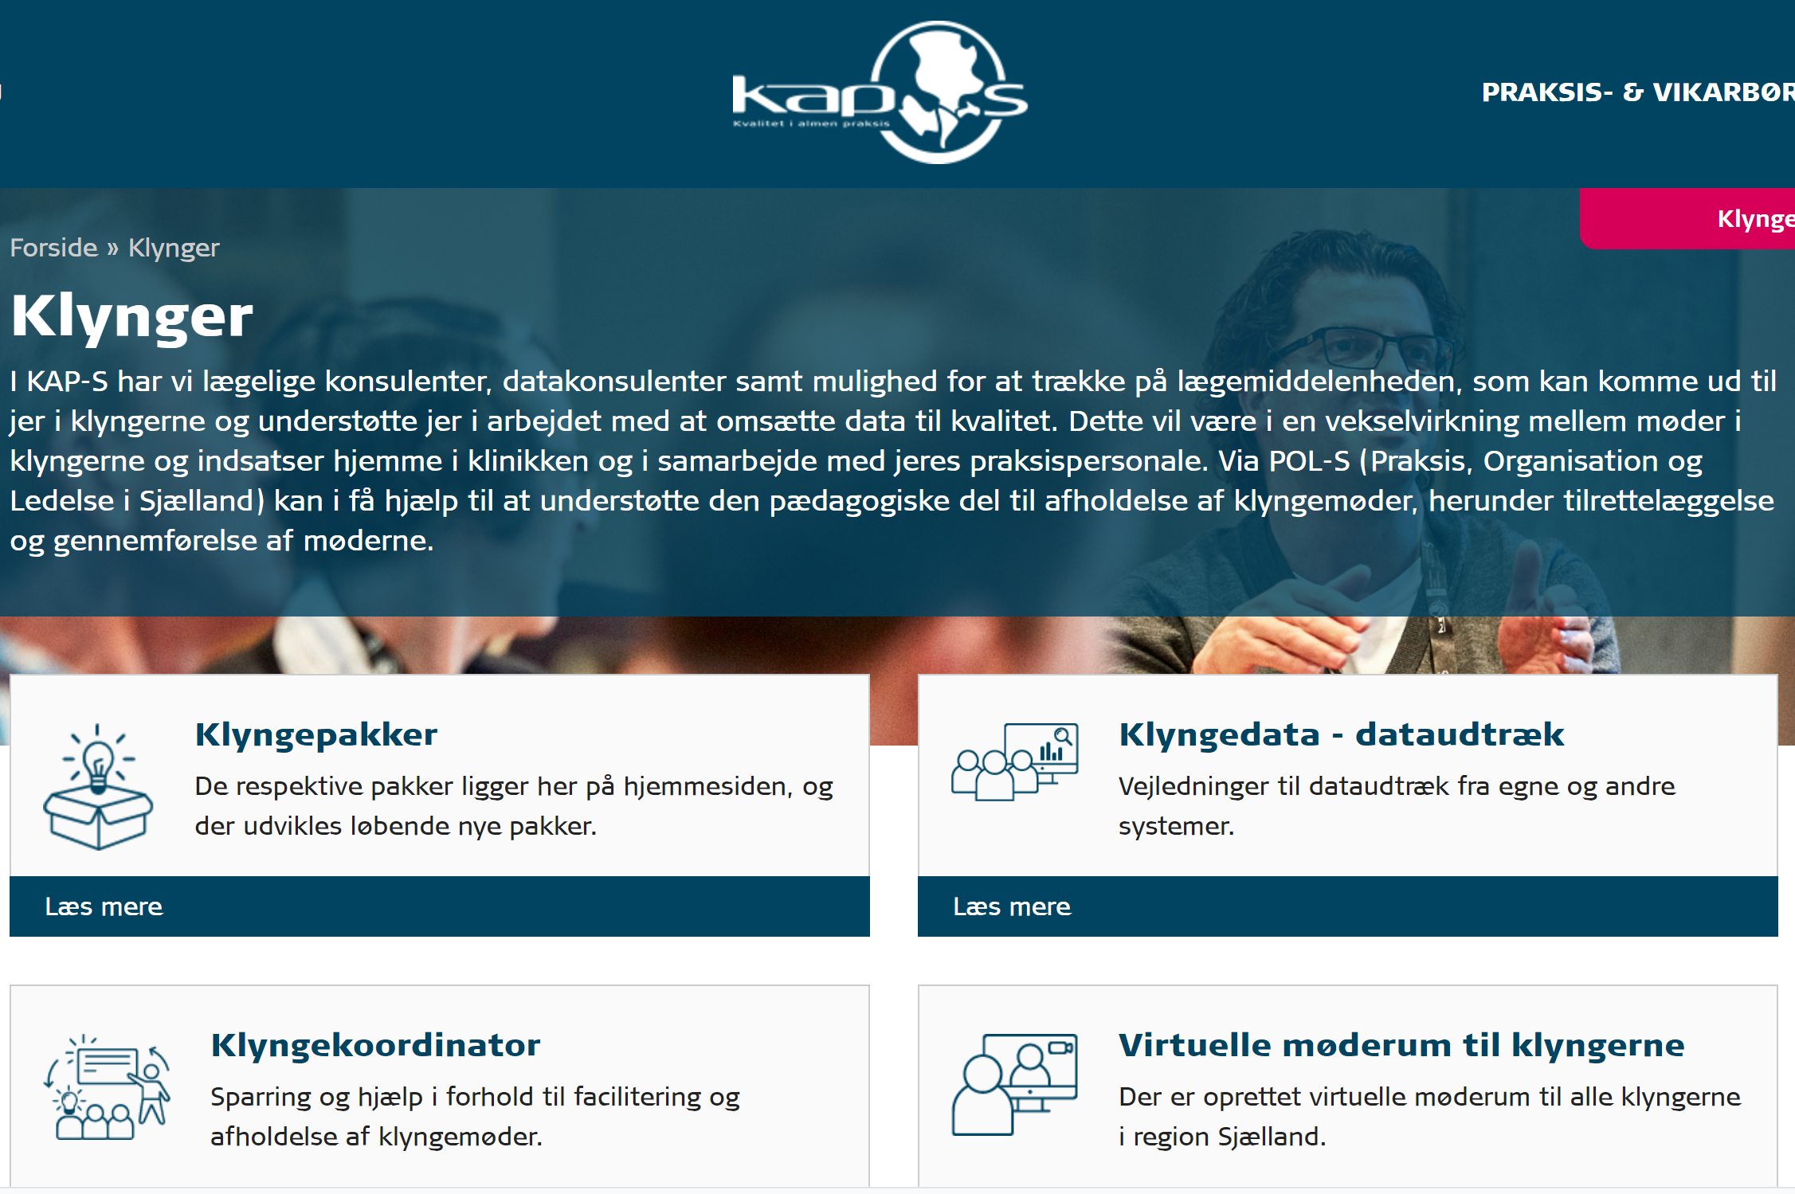
Regional clustersupport (Clusters and clinics)
The regional cluster and clinic support (KAP) offers "hands on" help with meetings and implementation:
Facilitation of meetings
Cluster packages
Data from region and municipalities
Visits at clinics
Dataconsulents
Medicine consulents
Regional network

Slide 9
Many partners want access to the clusters
Health board: ”Breafing on new guidelines”
Other authorities: ”Breafing on holiday law”
Researcher: ”Projects in the cluster”
Municipalitiese: ”Information about dosisdispensation of medicine”
Patient associations: ”We would like to use the clusters to do patient studies”

Slide 10



But remember the purpuse of clusters
…the quality work is experienced as relevant and so close to practice, that the individual GP works with data-driven quality development in their own clinic…
Only 3-4 meetings/year
Topics are selected by clustermembers
Topics are relevant for daly work in the clinics

Slide 11

KiAP’s Cluster data

Slide 12
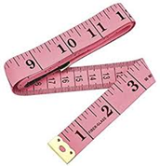
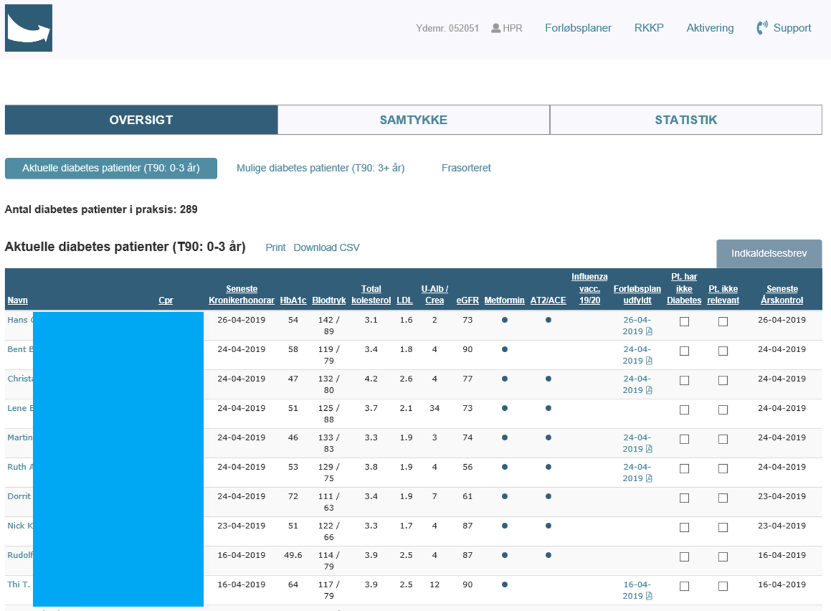
Courseplans - GP´s view

Slide 13
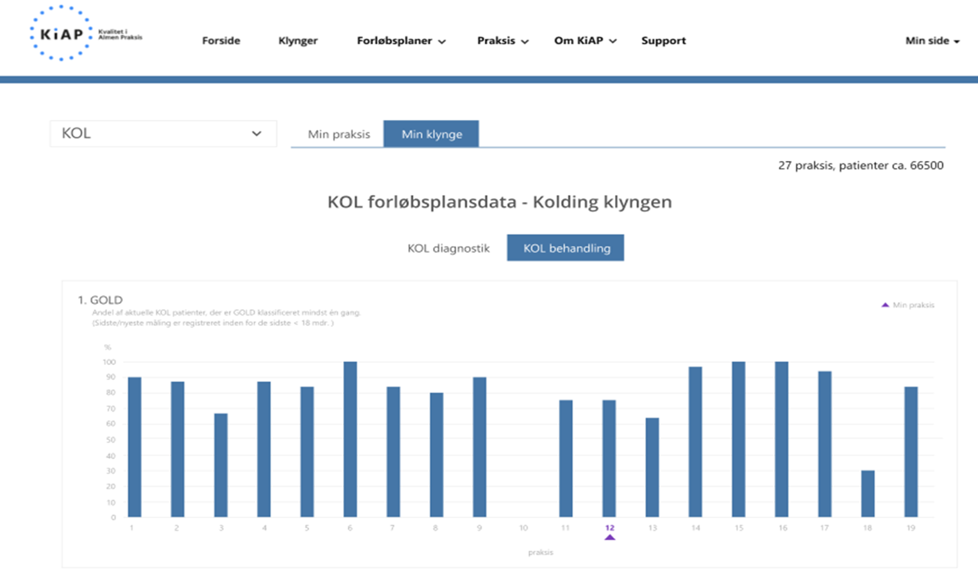
Courseplans – Cluster view

Slide 14
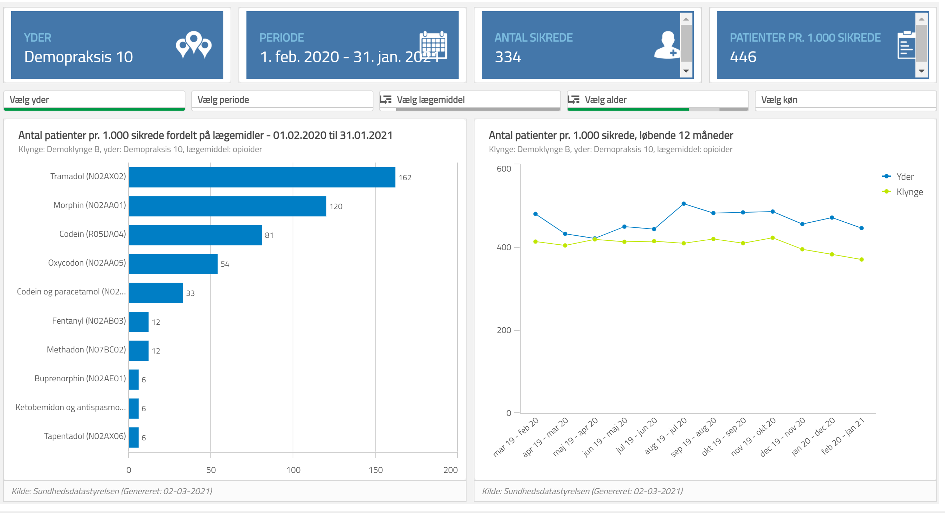
ordiprax+ GP´s view

Slide 15
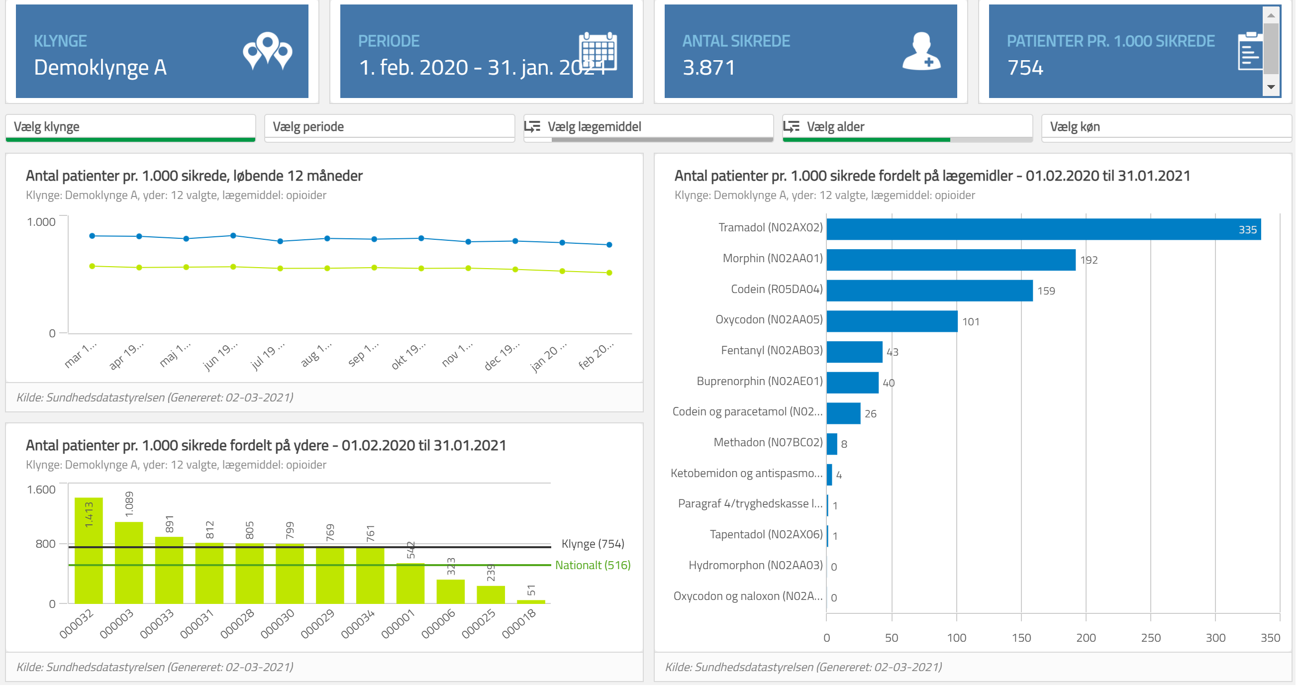
ordiprax+ Cluster view

Slide 16
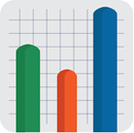
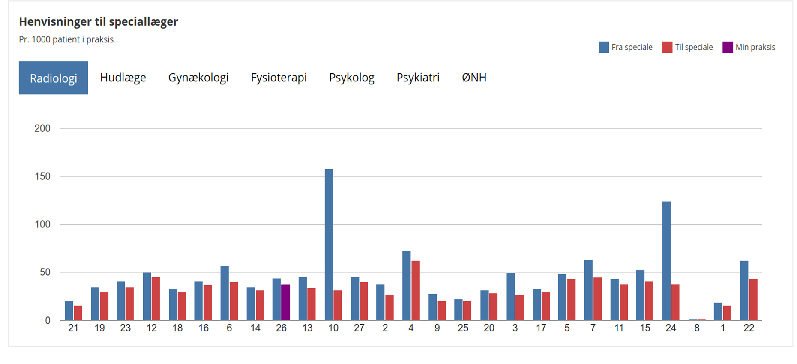
Electronic communication – Cluster view

Slide 17
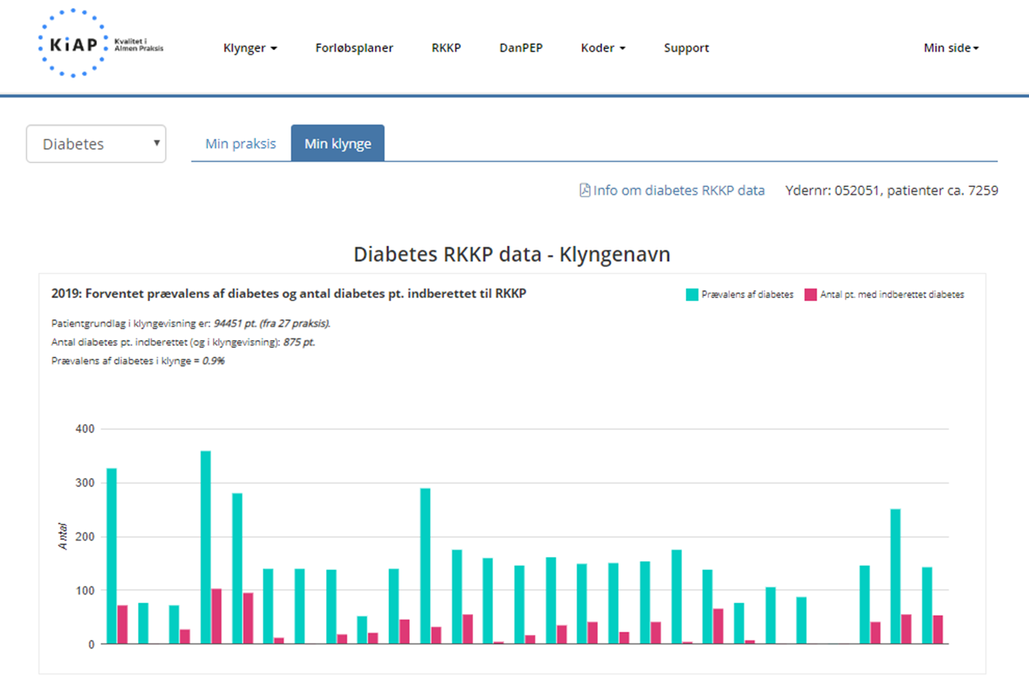
RKKP indicators – Cluster view

Slide 18
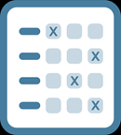
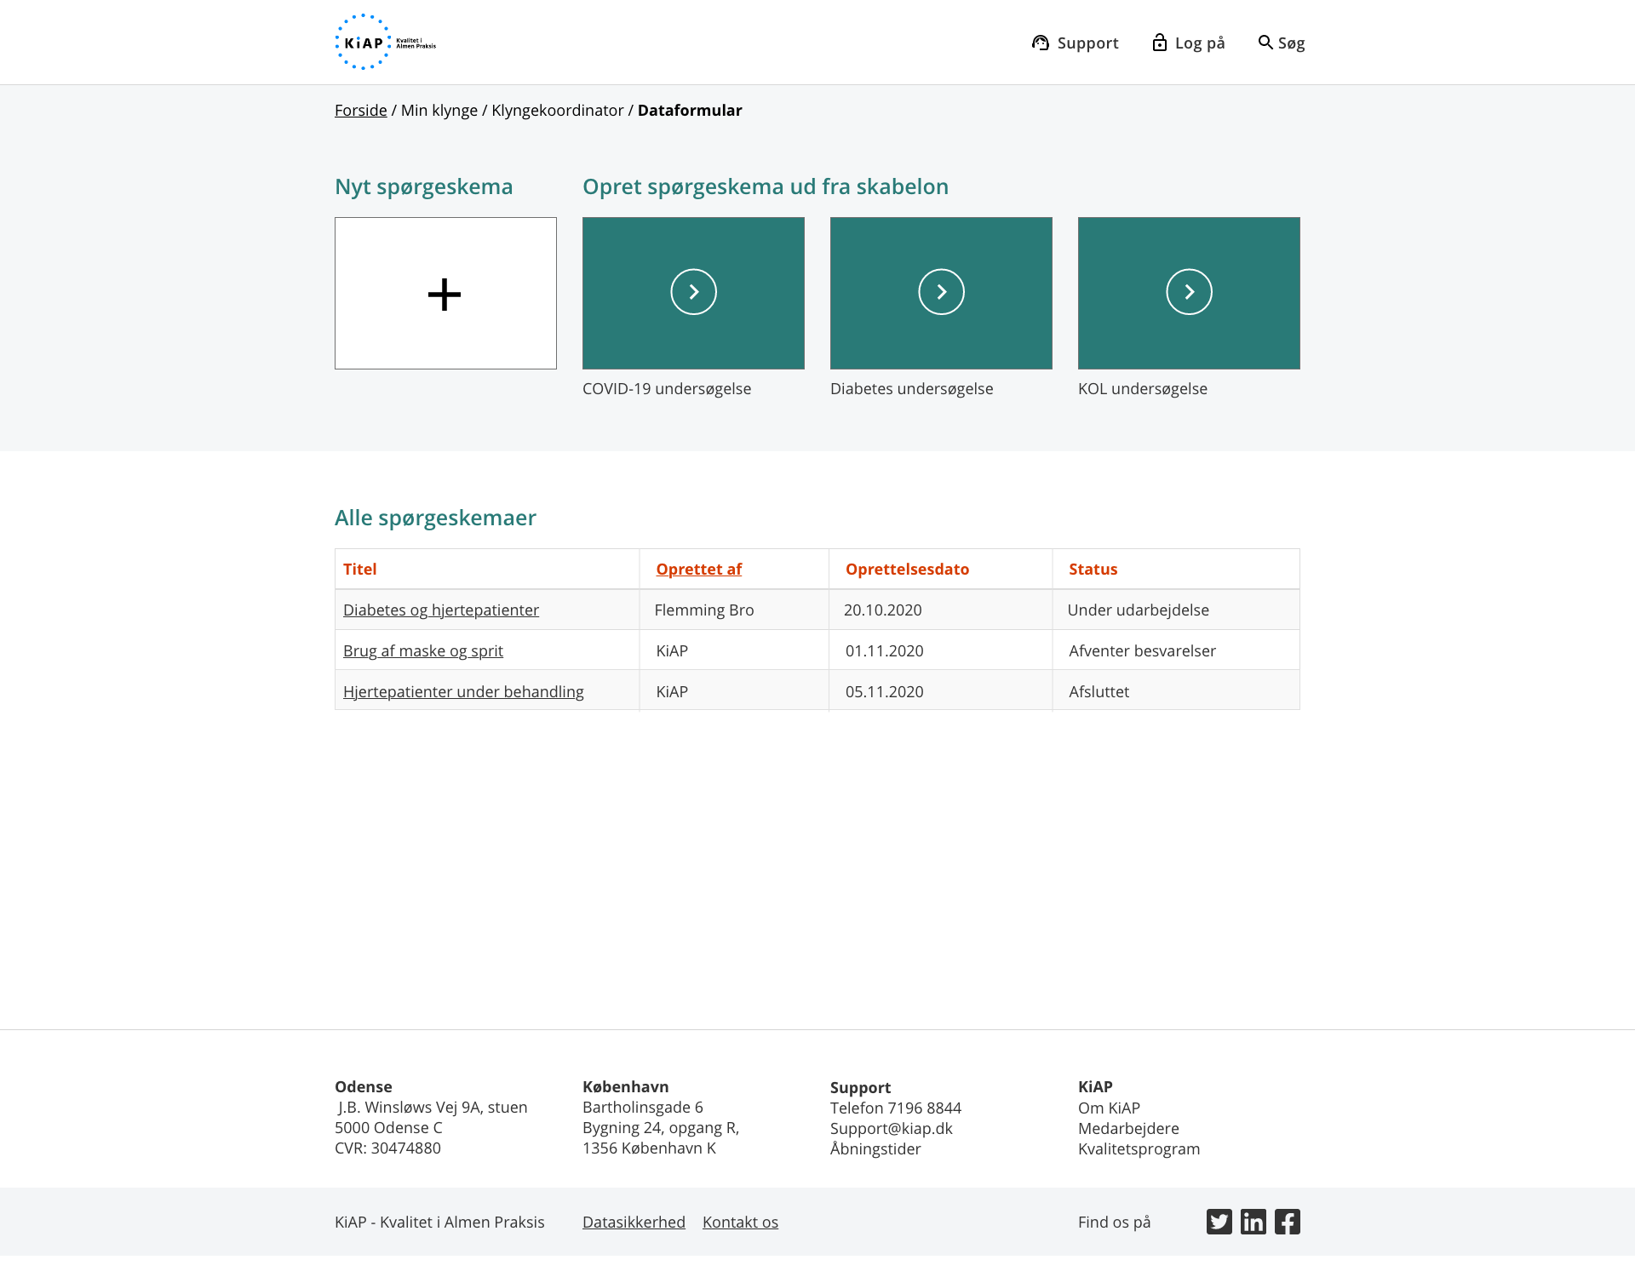
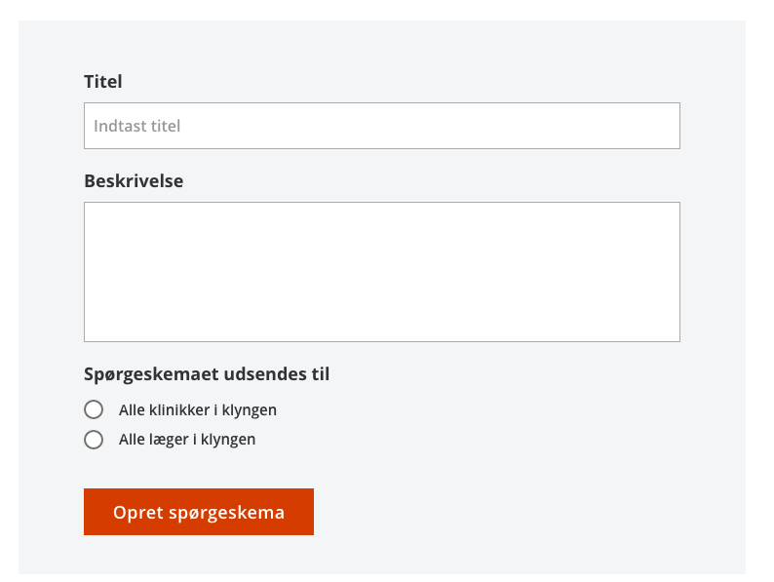
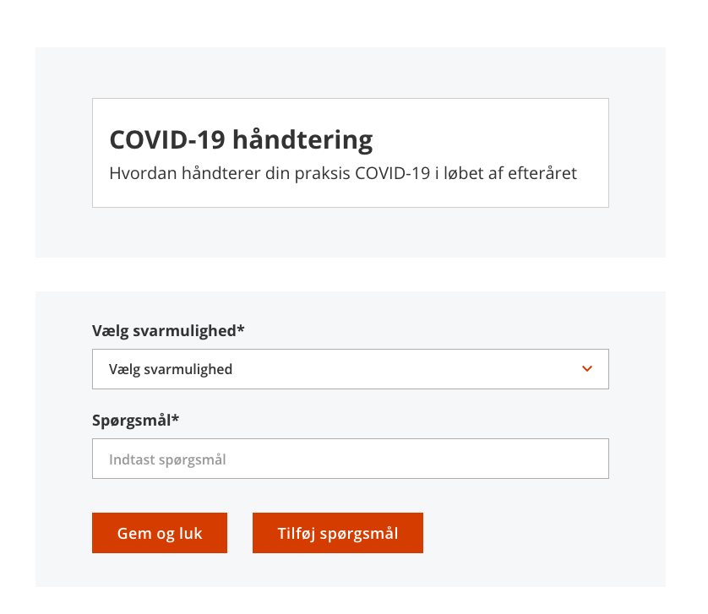
KiAP Cluster survey

Slide 19
KiAP’s Cluster help

Slide 20


What is a cluster package?
A professional review of a topic and a presentation of the data basis for the quality work in the cluster:
Screenplay that supports the chair of the cluster meeting in planning and conducting the meeting incl. program for the meeting.
A finished PowerPoint presentation for the meeting.
Completed data pull or help in obtaining data for the cluster meeting.
Suggestions for organizing group work, incl. reflection sheet
Support for implementation in practice

Slide 21
What is a cluster package?
Before meeting
Podcast
Video
Data
During meeting
Group based learning
Plan for implementation
After meeting
Implementation video
Examples of instructions

Slide 22

Program | Hvordan | Tid
Velkomst og introduktion til dagens program og tema | Plenum | 15 min.
Blok 1: Simple kroniske smerter
Introduktionsvideo og oplæg til gruppearbejde | Plenum | 10 min.
Gruppearbejde | Sidemand | 10 min.
Gennemgang – hvad har vi talt om? | Plenum | 5 min.
PAUSE |  | 10 min.
Blok 2: Komplekse kroniske non-maligne smerter
Introduktionsvideo og oplæg til gruppearbejde | Plenum | 15 min.
Gruppearbejde | Grupper | 15 min.
Gennemgang – hvad har vi talt om? | Plenum | 10 min.
Blok 3: Valg af præparat
Introduktionsvideo og oplæg til gruppearbejde | Plenum | 10 min
Gruppearbejde | Grupper | 10 min
Gennemgang – hvad har vi talt om? | Plenum | 5 min.
Afslutning af mødet
Opsamling på dagens møde | Plenum | 5 min.
Hvad tager jeg med hjem – egen refleksion | Alene | 5 min .
Notes:
Programmet er sammensat så det samlet tager 2 timer og 5 min. med opdeling i en introduktion til mødet og emnet, 3 blokke samt en afslutning med lidt tid til refleksion.

Slide 23
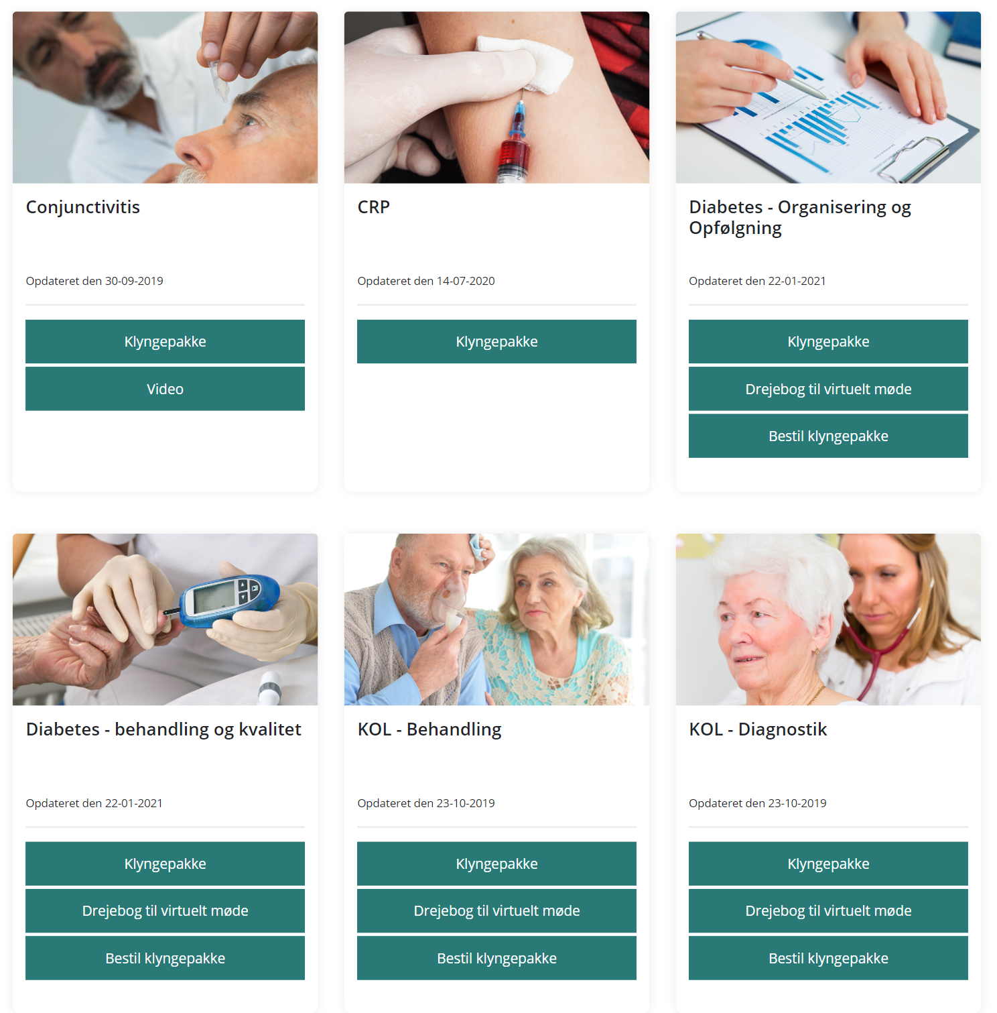
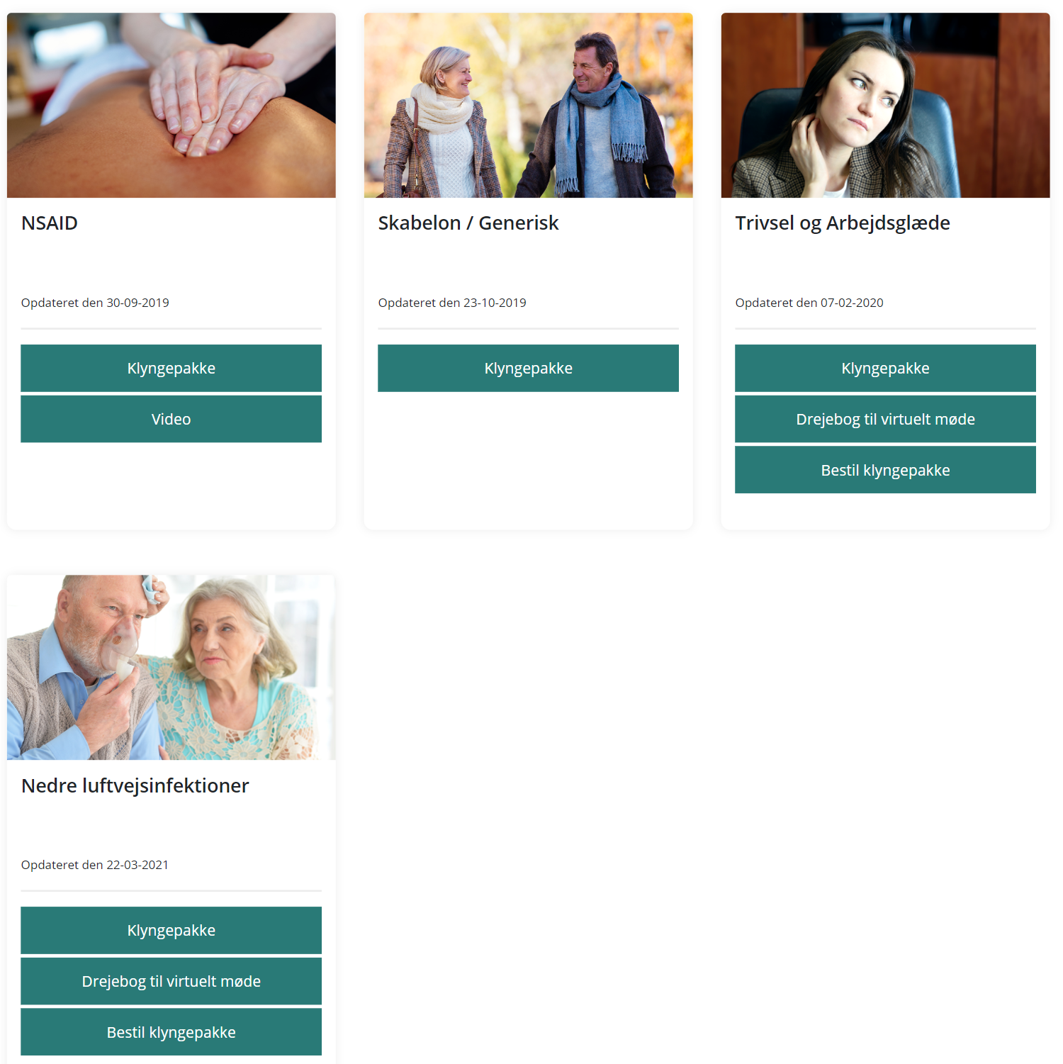

KiAP’s Cluster packages

Slide 24
Good clusterstories
Find them and share them!

Slide 25
Conjunctivitis: KOOL-cluster
Significant change in the use of antibiotics
Less use of Fucidine acid - lower risk of antibiotic resistance

Slide 26
Updating medicine – Nordfyns cluster
National goal of updating medication information
This is a task for GP´s
Data is not delivered automatically from FMK

Slide 27

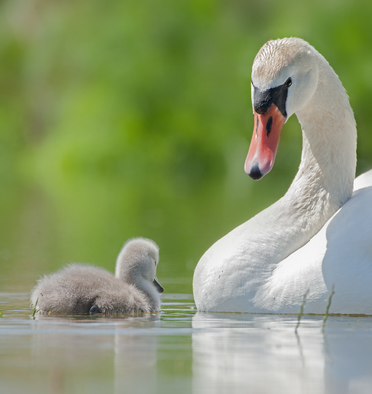
Thank you for your attention
Notes:
KiAP bliver en smuk svane!

